Slide 1
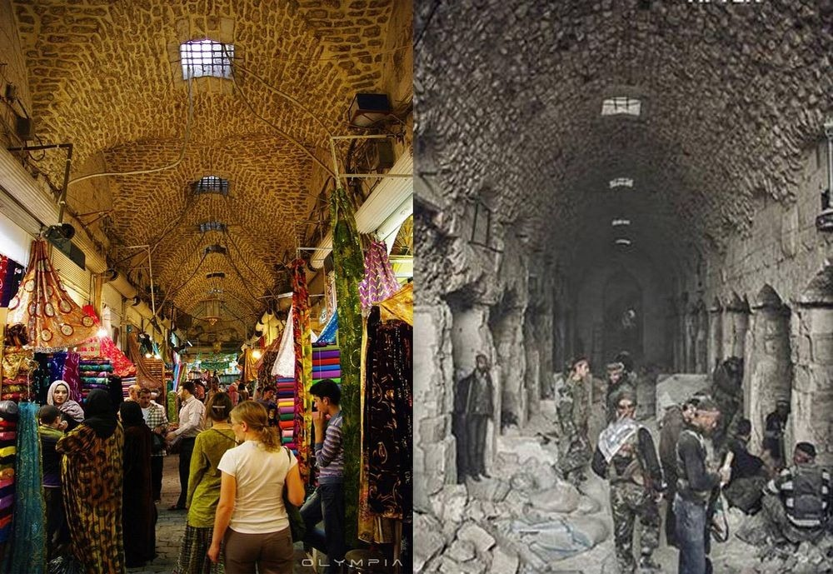
What you see here is ‘before’ and ‘after’ images.
Where are we?
How do you know that is where we are?
What do you know about these events?

Slide 2
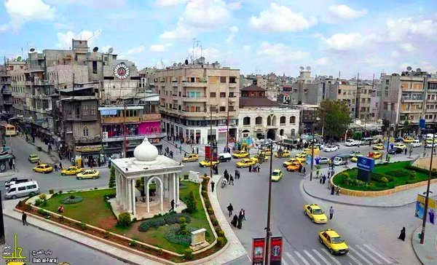
GCSE: Paper 2 Language
Transactional Writing

Slide 3
Learning Question: What is transactional writing and how can it be taught through the Syrian Crisis?
5. Plenary: Reflection.
4. Sharing our thoughts.
3. Becoming Informed.
2. A bit of background: The exam context.
Starter: What is happening here?

Slide 4

Which skills will we focus on today?

Slide 5

This module we are studying Transactional Writing:
On the Edexcel English Language Paper 2, you will be given time to write a piece of transactional (non-imaginative) writing. It may take one of the following forms:
Informal letter
Formal letter
Speech
Article
Report
Leaflet
Review

Slide 6
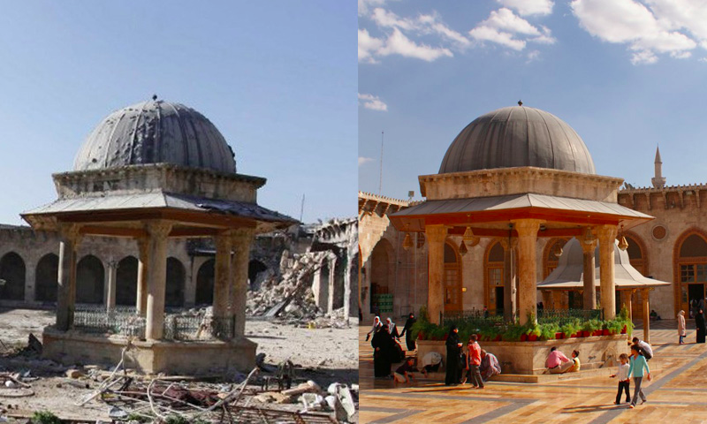
This module’s focus:
To teach you these forms and how to write them in a structurally correct way, we will be creating tasks based on the experience of Syrian people caught up in the Civil War.
This will allow you to focus on audience and purpose for each task and also allow you to become more aware of this major humanitarian issue.

Slide 7
Learning Question: What is an informal letter and what are the key features?
5. Plenary: Reflection.
4. Sharing our thoughts.
3. Becoming Informed.
2. A bit of background: The exam context.
Starter: What is happening here?

Slide 8
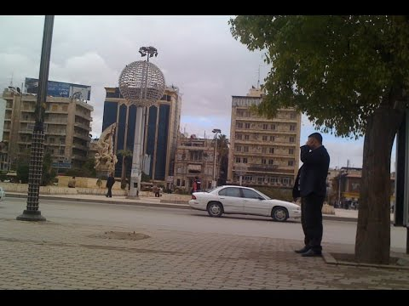
What was Aleppo like before the Civil War?
https://www.youtube.com/watch?v=k2W1rPBy208

Slide 9

The Syria I Knew
Now we are going to read a reflection by the Dina Shahrokhi about the Syria she knew before the war.
As we read, you will each be given parts to read to the class - think about how this would be said, and if your section confuses you, you can ask me while we prepare to present.

Slide 10
Learning Question: What is an informal letter and what are the key features?
5. Plenary: Reflection.
4. Sharing our thoughts.
3. Becoming Informed.
2. A bit of background: The exam context.
Starter: What is happening here?

Slide 11
Discussion
What surprised you about the way Syria has been shown to you today?
Does it change how you feel about people from that country?
Are there questions you still have about Syria before the Civil War?
What do you think life would have been like for you if you had lived/been born in Syria?

Slide 12
Learning Question: What is an informal letter and what are the key features?
5. Plenary: Reflection.
4. Sharing our thoughts.
3. Becoming Informed.
2. A bit of background: The exam context.
Starter: What is happening here?

Slide 13
Which skills did you successfully use in lesson today?

