Slide 1
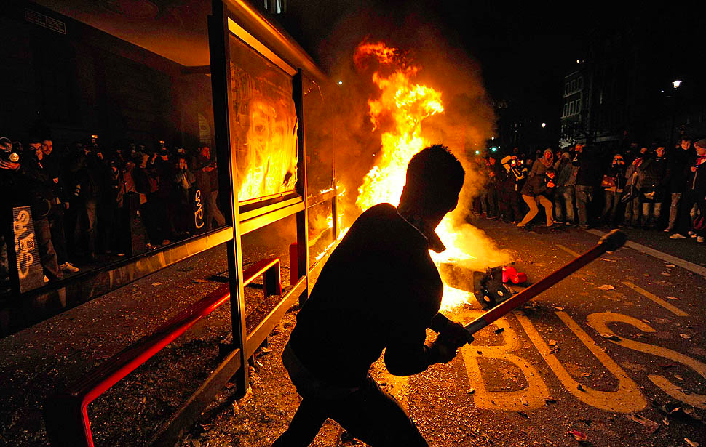
It’s a fairly normal day. You are headed to the academy, and you hear that there have been protests up North.
The police have been involved in breaking up the protests and you hear that there has been violence and some people have died. How does this make you feel?

Slide 2
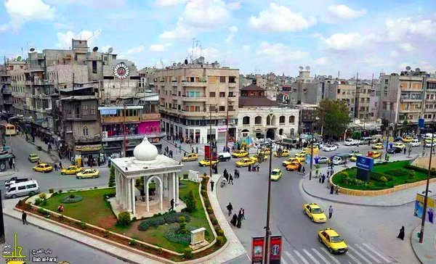
GCSE: Paper 2 Language
Informal Letters

Slide 3
Learning Question: How could we learn about informal letters through the Syrian Crisis?
5. Plenary: Reflection.
4. Peer Assess.
3. A letter to my cousin in England.
2. A normal day.
Starter: The protests.

Slide 4

Today you should focus on:
Caring
Self-Assurance
Originality

Slide 5
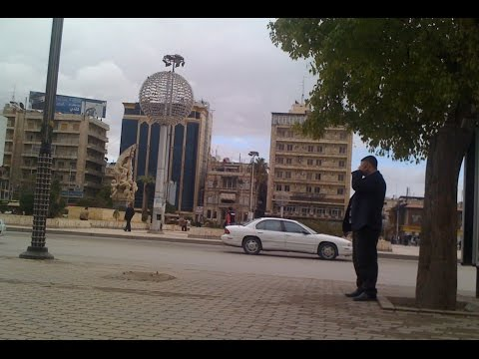
A Normal Day. Watch the following video and imagine yourself a school student, heading to school one morning.

Slide 6
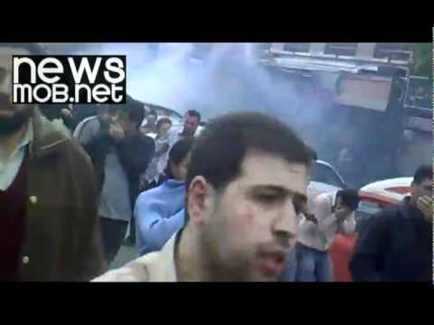
When you come home there are reports on the news about protests in Damascus against the government who have been accused of corruption.

Slide 7
Learning Question: How could we learn about informal letters through the Syrian Crisis?
5. Plenary: Reflection.
4. Peer Assess.
3. A letter to my cousin in England.
2. A normal day.
Starter: The protests.

Slide 8
A Letter to your cousin
You and your parents are pretty shocked by the raw footage from the protests.
After watching the news you decide to write a letter to your cousin in England. You have been writing to each other for years, a legacy from your childhood when your parents first encouraged you to be penpals.

Slide 9

What is an informal letter?
An informal letter is designed to inform and entertain a reader, who will be known to the writer on a personal level.
They are written in the 1st Person.
They begin with an informal greeting (Hey, Dear _____) and end with an informal farewell (Love, Talk soon).

Slide 10
Your Task
You are to write an informal letter to your cousin in England about recent events at home.
Genre: Letter
Audience: Your cousin in England
Purpose: To inform them about what has been going on in Syria, and about your life in general.

Slide 11
A Letter to your cousin: Informal Letter
Greeting
First paragraph: ask how they are, mention things from the previous letters you’ve written
Second paragraph: talk about what’s been going on in the family
Third paragraph: talk about what’s going on in the community and your concerns about the protests
Fourth paragraph: talk about when you hope to see them or when you will next write
Sign-off

Slide 12

Peer Assessment
Swap your book with a partner and peer assess their work in purple pen. You should mark for:
Correct capital letter use (C)
Use of correct sentence structure (NS)
Written in 1st Person
Written in an informal style
Is detailed and accurate
Provide a WWW and EBL.

Slide 13
Learning Question: How could we learn about informal letters through the Syrian Crisis?
5. Plenary: Reflection.
4. Peer Assess.
3. A letter to my cousin in England.
2. A normal day.
Starter: The protests.

Slide 14
How did you use these today?
Caring
Self-Assurance
Originality

Slide 15
Learning Question: How could we learn about informal letters through the Syrian Crisis?
5. Plenary: Reflection.
4. Peer Assess.
3. A letter to my cousin in England.
2. A normal day.
Starter: The protests.

