Slide 1
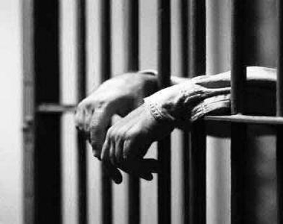
The protests have continued in the capital. The Assad Government have begun making arrests to curb the protests.
Your father is a respected member of the community; a businessman and respected in the mosque.
One day the police come and arrest your father. Your mother, a doctor, is terrified and no one can tell her where he is.
Eventually you find out he is accused of organising a rebellion. That was three months ago. How are you and your family feeling?

Slide 2
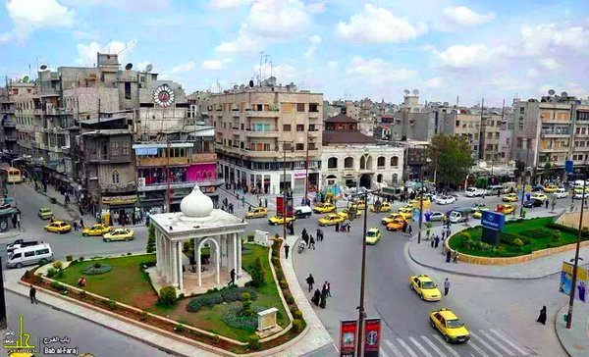
GCSE: Paper 2 Language
Formal Letters

Slide 3
Learning Question: How could we learn about formal letters through the Syrian Crisis?
5. Plenary: Reflection.
4. Peer Assess.
3. A letter to the British Immigration Bureau.
2. Fleeing Damascus.
Starter: What happened?

Slide 4

Today you should focus on:
Principled
Ambition
Caring

Slide 5
You come home one day to find your mother weeping. She has been sent a letter informing her that your father has died in police custody. No explanation of how he died. No explanation of what he was accused of other that “crimes against the State”. No trial was conducted. No compensation is made.
Your mother is terrified and has told you and your siblings to pack a bag immediately. You are going to travel to the North to live with your father’s brother and his family.
The Free Syrian Army has formed in the capital and are fighting with the National Armed Forces. Bombings have begun on the far side of the city. You need to leave Damascus.

Slide 6
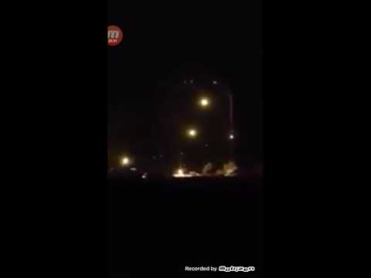
You flee North that night. As you leave the city, you can hear gunshots and look behind you to see this.

Slide 7
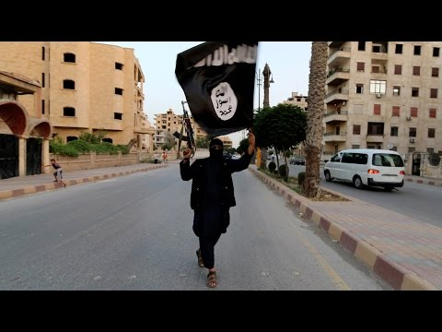
You have been living in the North for almost a year. There was no funeral for your father. Mother can’t hear his name spoken. You have been going to school each day, but have been told to walk quietly with your cousins. There are snipers. Then you are told that ISIS have invaded in a city to the North East.

Slide 8
A Letter to the British Immigration Bureau
Your mother has decided she has had enough. She is a qualified doctor which she believes will help her to apply for refugee status or a Visa to join family in England with you and your siblings.
For the application process, you will need to ask your family in the UK to create a formal letter explaining that you would have permission to live with them in the UK. This letter must identify:
The reasons why they are applying for refugee status
How they would be able to live with you in your home? Is there sufficient space for the number of people?
General character, profession and age/needs of dependants

Slide 9

What is a formal letter?
A formal letter is designed to inform and persuade the reader, who will not be known to the writer on a personal level.
They are written in the 1st Person.
They begin with a formal greeting (Dear _____, To whom it may concern) and end with a formal farewell (Yours faithfully, Yours sincerely).

Slide 10
Your Task
You are to write a formal letter to the British Immigration Bureau to support your sister’s application for a “Living with Family in the UK” Visa for her and her children.
Genre: Formal Letter
Audience: British Immigration Bureau
Purpose: To provide them with information that will support your sister’s visa application.

Slide 11
A Letter to British Immigration: Formal Letter
Greeting - Dear Sir/Madam, To whom it may concern,
First paragraph: Why you are writing, Living with Family in the UK Visa
Second paragraph: relationship to applicant, explain their current situation
Third paragraph: What they have been through, father, fled from Damascus to Aleppo
Fourth paragraph: arrangements when they arrive - housing, schools, work
Fifth paragraph: Please consider application
Yours faithfully or Yours sincerely

Slide 12

Peer Assessment
Swap your book with a partner and peer assess their work in purple pen. You should mark for:
Correct capital letter use (C)
Use of correct sentence structure (NS)
Written in 1st Person
Written in a formal style
Is detailed and accurate
Provide a WWW and EBL.

Slide 13
How did you use these today?
Principled
Ambition
Caring

