Slide 1
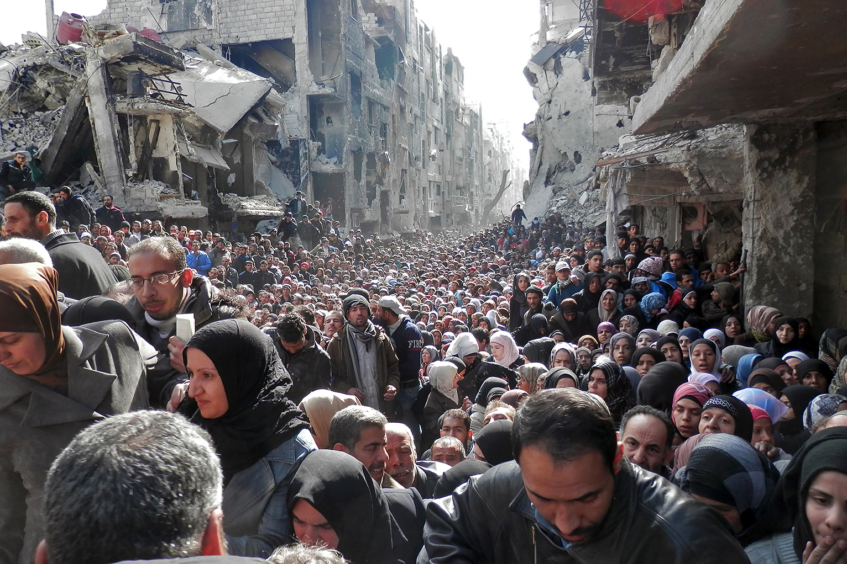
Your family has just received word about your application for residency in the UK. Only so many applications are passed at any one time, and you have been told your application has been unsuccessful.
ISIS are moving west and your mother is losing hope. There is only one option left. Cross the border and head for Turkey. There, your mother believes it will be easier to apply for the visa a second time.
Is this the right decision? What are the potential concerns?

Slide 2
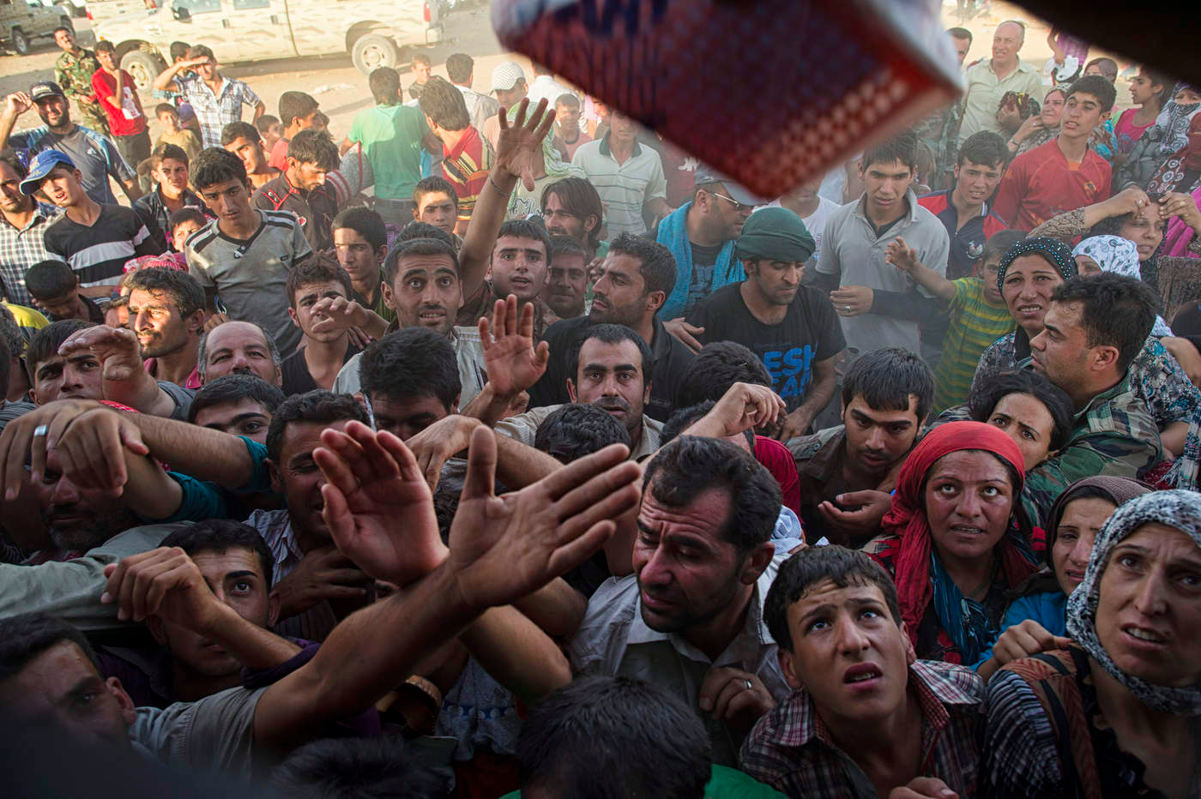
GCSE: Paper 2 Language
Articles

Slide 3
Learning Question: How could we learn about articles through the Syrian Crisis?
5. Plenary: Reflection.
4. Peer Assess.
3. A journalist’s perspective.
2. Conditions in a refugee camp.
Starter: A Long Journey.

Slide 4
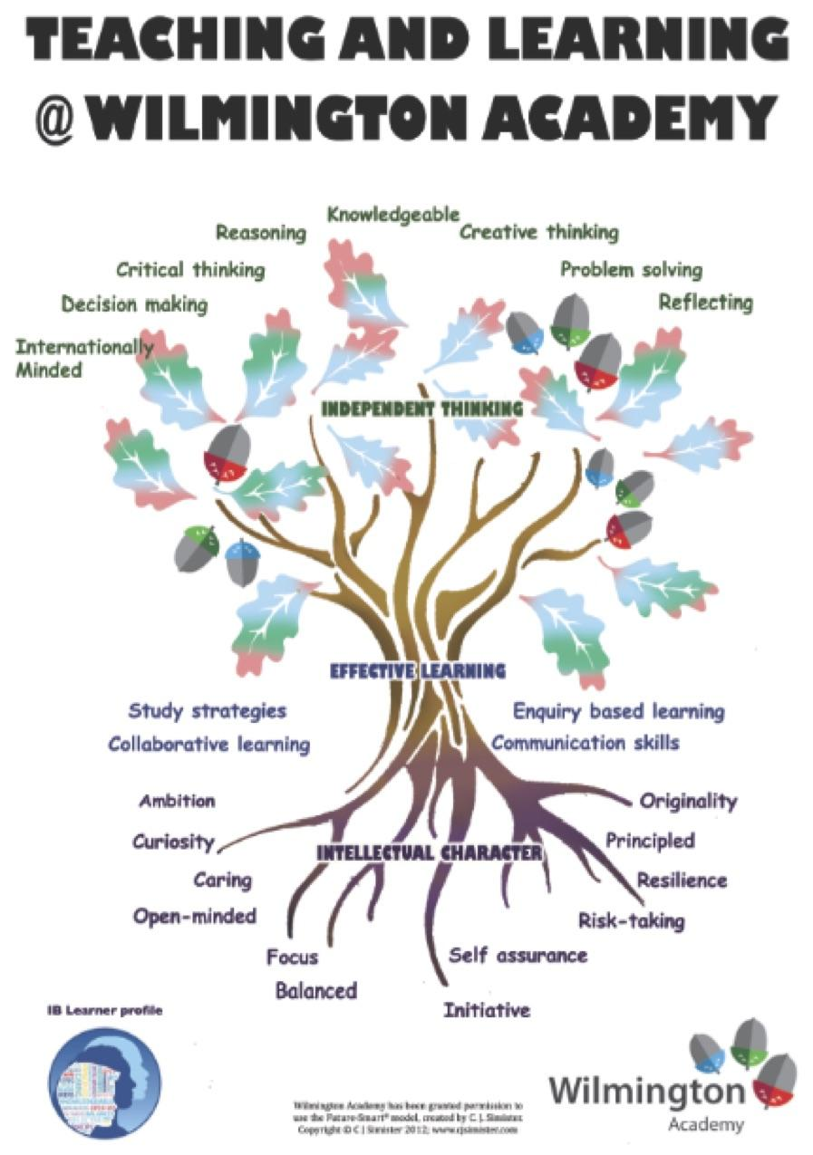
Today you should focus on:
Knowledgeable
Initiative
Principled

Slide 5
Your family are now heading to Turkey. The hope is to get to an airport and be able to fly to England. Once in England, you will be detained at Border Control, but will have the chance to apply for the ‘Living with Family in the UK Visa’ and may be more successful if you are already in the country.
On your journey to the Turkish border you read a newspaper article on the conditions in the refugee camps there.
You are going to transition roles in the story now and become the journalist who has written that article.

Slide 6
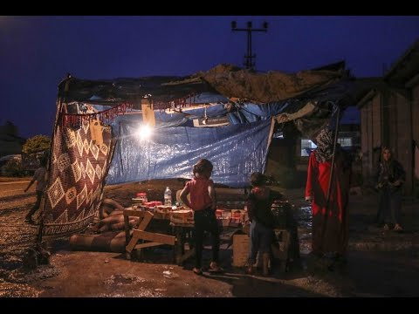
Conditions in Turkey

Slide 7
An Article on Conditions in Turkey
You have now become a journalist, reporting on the conditions in the refugee camps along Turkey’s border. Your article is written for a global audience of people who wish to be more informed about what refugees are experiencing.

Slide 8
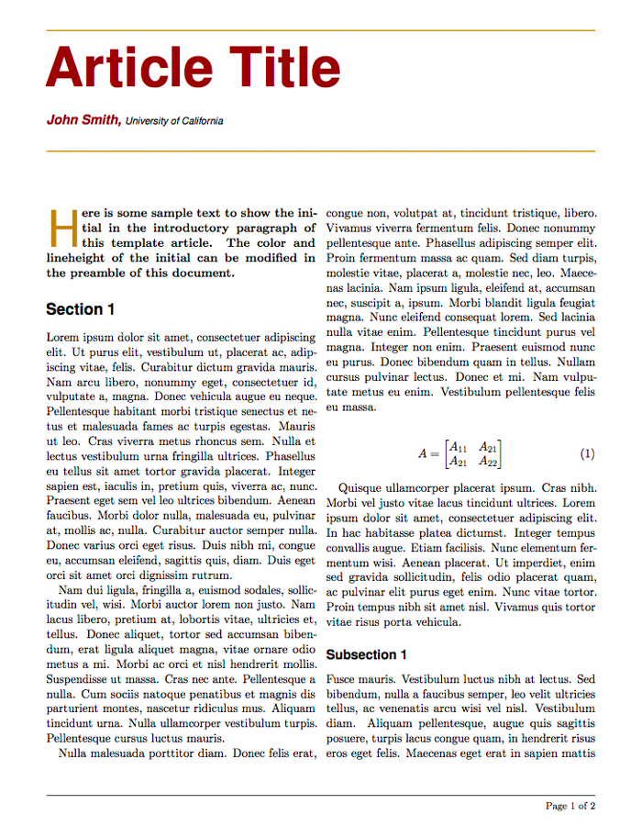
What is an article?
An article is designed to inform and persuade the reader about a specific topic or issue.
They are written in the 3rd Person.
They begin with a catchy title.
They have a ‘by’ line to show who wrote the article.
The first paragraph establishes who, what, where, when and why.
They use quotes from identified sources.

Slide 9
Your Task
You are to write an article explaining the conditions experienced by Syrian refugees living in Turkey.
Genre: Article
Audience: readers of the newspaper
Purpose: To provide them with information about the experiences of Syrian refugees in Turkey and what will happen to them next.

Slide 10
An Article: Begin with a memorable title
By Line
First paragraph: establish the who, what, where, when and why
Central paragraphs: provide more detailed information regarding the conditions in refugee camps, settlements, those trying to get to Europe, Aid Organisations helping, including quotes by a variety of people to lend credibility to the article
Final paragraph: looks to explain what will be happening in the future

Slide 11

Peer Assessment
Swap your book with a partner and peer assess their work in purple pen. You should mark for:
Correct capital letter use (C)
Use of correct sentence structure (NS)
Written in 3rd Person
Written in a formal style
Is detailed and accurate
Provide a WWW and EBL.

Slide 12
How did you use these today?
Knowledgeable
Initiative
Principled

