Slide 1
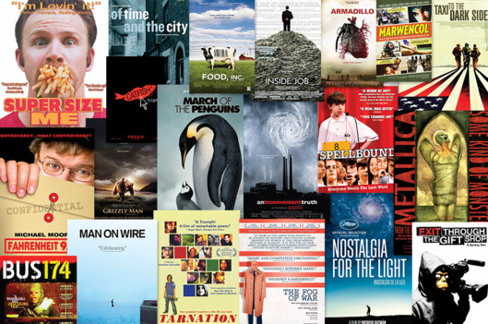
A documentary film is made based on real events and follows real people through interesting or challenging situations.
When did you last watch a documentary?
Do you have a favourite documentary?

Slide 2
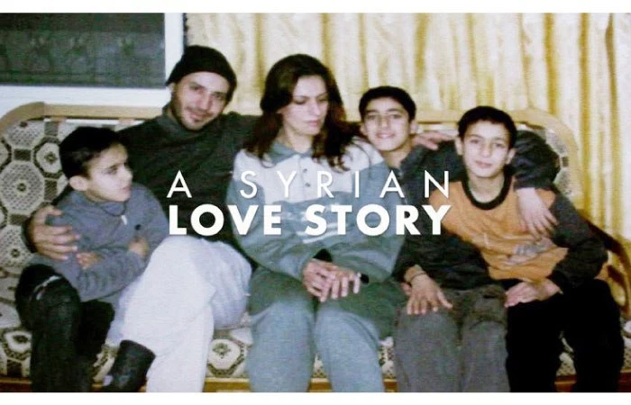
GCSE: Paper 2 Language
Reviews

Slide 3
Learning Question: How do we express our opinion of “A Syrian Love Story” in a review?
5. Plenary: Reflection.
4. Write a review of the film and self assess.
3. Watching the film “A Syrian Love Story”.
2. What is a review?
Starter: Documentaries.

Slide 4

Today you should focus on:

Slide 5
Today we are going to watch the film “A Syrian Love Story”. It follows a family who are devastated by factors involved in the Syrian Civil War.
In response to this documentary, we are going to write a review, a genre which allows you to formally express your opinion about anything, from a film, to a novel, to art, music, or a product.
As we watch the film, we will make notes of things we both like and dislike. They can be:
The way the film is made: cinematography, editing, sound
The family we focus on and how we feel about them

Slide 6
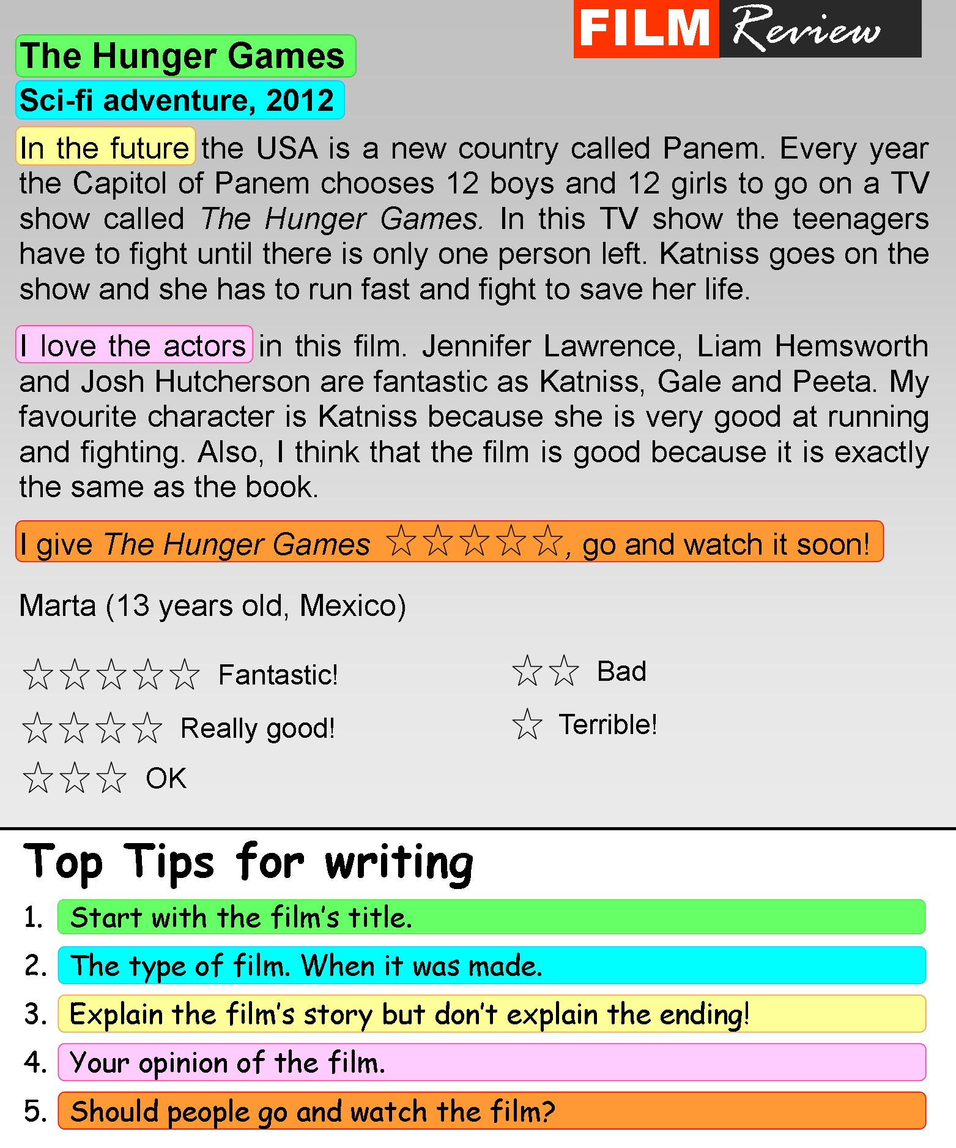
What is a review?
A review is a text that judges the merits of a piece of media (a movie, music album, exhibition, show, or novel).
They are written in the 1st Person.
They begin with a catchy title.
They have a ‘by’ line to show who wrote the article.
They always include a rating scale.
They include both pros and cons.

Slide 7
Your Task
You are to write a review of the film ‘A Syrian Love Story’.
Genre: Review
Audience: people interested in the item being reviewed
Purpose: To provide them with information about the pros and cons of the item being reviewed.

Slide 8
Learning Question: How do we express our opinion of “A Syrian Love Story” in a review?
5. Plenary: Reflection.
4. Write a review of the film and self assess.
3. Watching the film “A Syrian Love Story”.
2. What is a review?
Starter: Documentaries.

Slide 9
Review: Title about “Cries from Syria”
By Line and Rating
First paragraph: establish the who, what, where, when of the film (include the director’s name)
Second paragraph: the inspiration for the film and the events it focusses on and why
Third paragraph: the positives about the documentary
Fourth paragraph: the negatives about the documentary
Fifth paragraph: your overall opinion and who you would recommend this film to

Slide 10

Self Assessment
Self assess their work in pink pen. You should mark for:
Correct capital letter use (C)
Use of correct sentence structure (NS)
Use of connectives
Correct Spelling
Written in 3rd person with a personal feel
Written in a formal style with personal tone
Is detailed and accurate
Has a title, By line and rating
Provide a WWW and EBI.

Slide 11
Learning Question: How do we express our opinion of “A Syrian Love Story” in a review?
5. Plenary: Reflection.
4. Write a review of the film and self assess.
3. Watching the film “A Syrian Love Story”.
2. What is a review?
Starter: Documentaries.

Slide 12
How did you use these today?
Knowledgeable
Initiative
Principled

