Slide 1

Persuasion
When was the last time you tried to persuade someone to do something/go somewhere?
Was it your parents/carers, friends..?
Make a list of at least three occasions.
Did you get what you wanted?

Slide 2
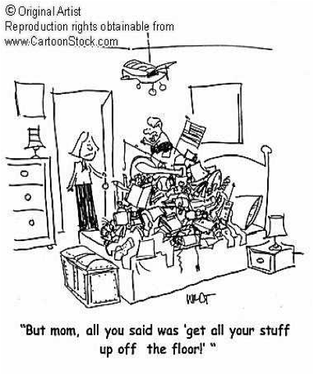
What about a time when your parent/carer tried to persuade you to do something?
What was it and what did they say?
Think about the TONE you both used.
What was successful and what failed?

Slide 3
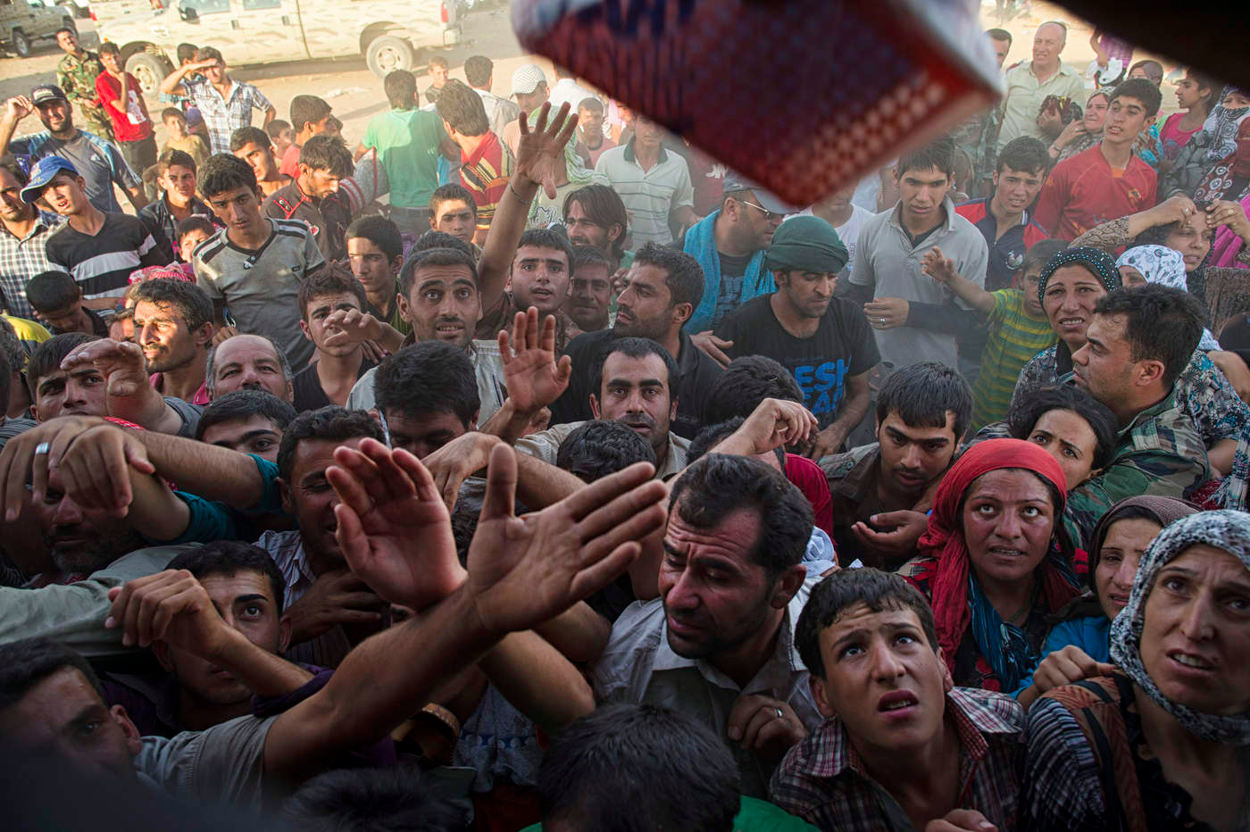
GCSE: Paper 2 Language
Persuasive Language

Slide 4
Learning Question: How could we learn about speeches through the Syrian Crisis?
5. Plenary: Reflection.
4. Write a speech.
3. Analyse a speech.
2. Persuasive Techniques.
Starter: Persuade a loved one.

Slide 5

Today you should focus on:
Creative Thinking
Critical Thinking
Decision Making

Slide 6
When people write to persuade they choose their words very carefully!
When you write to persuade you need to be A PERSUADER!

Slide 7
 | Technique | Definition
P | Personal Pronouns | You, me, us - create a bond with reader
E | Emotive Language | Words which create an emotional response (make the reader feel happy/sad/sympathy etc)
R | Rhetorical Question | Question that doesn’t need an answer
S | Statistics and facts | To prove a point - these can be made up!
U | Using an authority figure | To make your argument sound more convincing - make up a name!
A | Alliteration | Words that start with the same letter - makes your argument memorable.
D | Description and Imagery | Use metaphors and similes to describe ideas.
E | Exaggeration | Make your points over the top to prove your point.
R | Repetition and triplets | Repeat things and use three words to describe something (fit, fast and funny).

Slide 8
Learning Question: How could we learn about speeches through the Syrian Crisis?
5. Plenary: Reflection.
4. Write a speech.
3. Analyse a speech.
2. Persuasive Techniques.
Starter: Persuade a loved one.

Slide 9
Now it is time to see if you can identify them.
We are going to watch the President’s Speech from the alien adventure film ‘Independence Day’.
After we watch it you will have time in your groups to go through the speech and highlight and annotate where the techniques are in the speech.

Slide 10
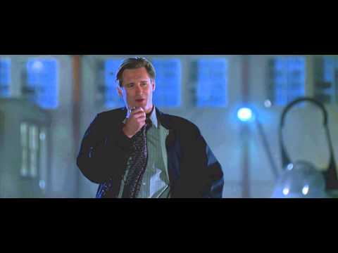

Slide 11
The President: Good morning. In less than an hour, aircraft from here will join others from around the world. And you will be launching the largest aerial battle in this history of mankind.
Mankind -- that word should have new meaning for all of us today.
We can't be consumed by our petty differences anymore.
We will be united in our common interests.
Perhaps it’s fate that today is the 4th of July, and you will once again be fighting for our freedom, not from tyranny, oppression, or persecution -- but from annihilation.
We're fighting for our right to live, to exist.
And should we win the day, the 4th of July will no longer be known as an American holiday, but as the day when the world declared in one voice:
"We will not go quietly into the night!
We will not vanish without a fight!
We're going to live on!
We're going to survive!"
Today, we celebrate our Independence Day!

Slide 12
Learning Question: How could we learn about speeches through the Syrian Crisis?
5. Plenary: Reflection.
4. Write a speech.
3. Analyse a speech.
2. Persuasive Techniques.
Starter: Persuade a loved one.

Slide 13
Now that you have seen persuasive techniques in action, create examples for each one that you could use in the following scenario:-
You hear other students talking about how they would not want Syrian refugees here at Wilmington Academy because they are “probably terrorists”.
Use persuasive language to challenge the prejudice of their views.

Slide 14
Learning Question: How could we learn about speeches through the Syrian Crisis?
5. Plenary: Reflection.
4. Write a speech.
3. Analyse a speech.
2. Persuasive Techniques.
Starter: Persuade a loved one.

Slide 15
How did you use these today?
Creative Thinking
Critical Thinking
Decision Making

