Slide 1
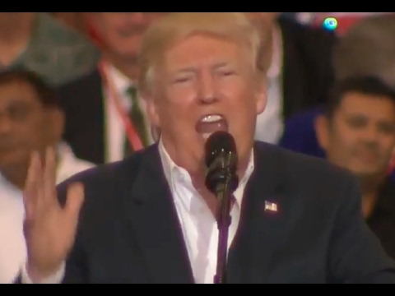
Donald Trump on Syrian Refugees
(Note: He was referring to a terrorist attack in Sehwan, Pakistan, not Sweden. This speech happened on 19 February 2017)

Slide 2
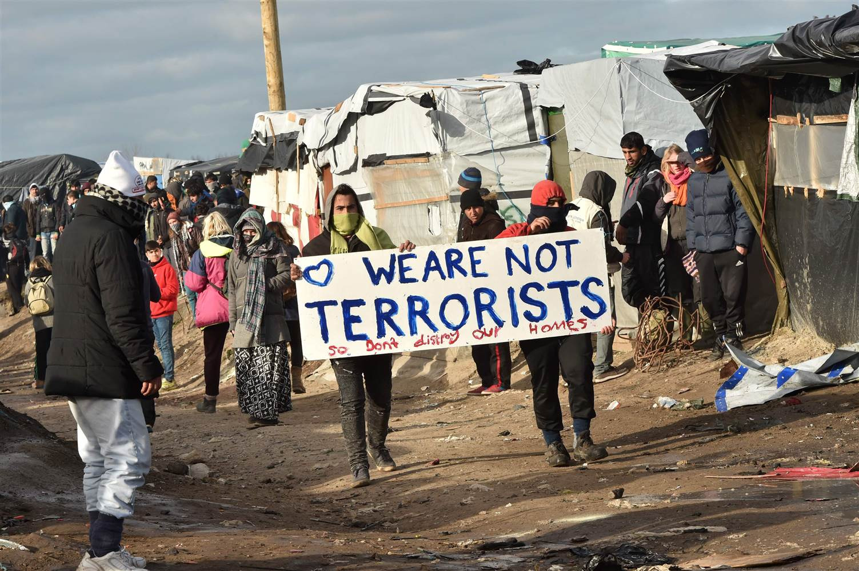
GCSE: Paper 2 Language
Speeches

Slide 3
Learning Question: How could we create a speech to educate others about the Syrian Crisis?
5. Plenary: Reflection.
4. Peer Assessment.
3. Constructing a speech.
2. Defining a position.
Starter: Trump’s Opinion.

Slide 4

Today you should focus on:
Risk-taking
Ambition
Originality

Slide 5
Your family have arrived in the UK and are living with their cousins. It has been a horrific journey, having lived in a refugee camp for a number of months before being able to gain access to Turkey, and get on a plane to the UK.
You were detained by Border Control, but your mother, despite all she has been through, completed all documents, was patient with Border officials, and when you came through Customs your cousins were waiting for you.
Maybe now there is a chance for a future. Maybe now there is a chance to be safe.

Slide 6
A British School Day
You have settled into a new school, in Year 10. It is the middle of the year and things are so different here, but you are making friends and you are doing well in your subjects.
One day you overhear some other students in the restaurant talking about refugees; they are saying that it can’t be that bad, and maybe they just made the war so they would have an excuse to come here and live on Welfare.
You are so mad. You want to tell them that they have no idea what they are talking about, but instead you just walk away.

Slide 7
Learning Question: How could we create a speech to educate others about the Syrian Crisis?
5. Plenary: Reflection.
4. Peer Assessment.
3. Constructing a speech.
2. Defining a position.
Starter: Trump’s Opinion.

Slide 8

What is a speech?
A speech is a text designed to persuade a listener to agree with the speaker’s point of view.
They are written in the 1st Person.
They begin with an anecdote or story.
They use a variety of persuasive language techniques.

Slide 9
Your Task
You are to write a speech explaining your position on the Syrian Refugee Crisis
Genre: Speech
Audience: members of your Year group in lesson
Purpose: To provide them with information about the Syrian Refugee Crisis and help persuade them to your way of thinking.

Slide 10
Speech Writing for the GCSE
For your exam, you will have only 55 minutes to write a cohesive speech, but they want to see certain features of speeches that are non-negotiable.
Start with an emotive introduction or anecdote
Introduce yourself and what you will be speaking about
Organise your ideas logically so that your strongest arguments are at the end of the speech
Use persuasive language devices
Conclude by putting a challenge to your audience and thank them for listening

Slide 11
Speech
Introduction: engage/hook your audience, just like in a narrative piece
First paragraph: establish who you are, what you are talking about and why
Second paragraph: background of the Syrian conflict
Third paragraph: what’s happening there now
Fourth paragraph: what refugees are going through, why they are leaving Syria
Final paragraph: appeal to your audience to agree with your point of view

Slide 12

Peer Assessment
Swap your book with a partner and peer assess their work in purple pen. You should mark for:
Correct capital letter use (C)
Use of correct sentence structure (NS)
Written in 1st Person
Written in a formal style
Uses a range of persuasive language
Use of connectives between sections
Is detailed and accurate
Provide a WWW and EBL.

Slide 13
Learning Question: How could we create a speech to educate others about the Syrian Crisis?
5. Plenary: Reflection.
4. Peer Assessment.
3. Constructing a speech.
2. Defining a position.
Starter: Trump’s Opinion.

Slide 14
How did you use these today?
Risk-taking
Ambition
Originality

