Slide 1

You are walking home from school and you trip and fall heavily. You feel an immediately horrendous pain in your leg and it is tilted at an odd angle.
What and who are available to help you from this point?

Slide 2

GCSE: Paper 2 Language
Leaflets

Slide 3
Learning Question: How could we create a leaflet to educate people about the work of CARE International?
5. Self Assessment.
4. Constructing a leaflet.
3. Learning about the work of CARE International.
2. What is a leaflet?
Starter: In need of help.

Slide 4

Today you should focus on:
Knowledgeable
Internationally Minded
Enquiry Based Learning

Slide 5

What is a leaflet?
A leaflet is designed to inform readers about a topic or organisation.
They are often written in columns but in your exam you won’t need to.
They directly address the reader.
They have a title, and subheadings for each section.
They use bullet points to summarise key facts, within certain subheadings.

Slide 6

Your Task
You are to write a leaflet about CARE International, a charity that has worked with Syrian Refugees.
Genre: Leaflet
Audience: anyone wishing to learn more about CARE International
Purpose: To provide them with information about the charity CARE International.

Slide 7
Learning Question: How could we create a leaflet to educate people about the work of CARE International?
5. Self Assessment.
4. Constructing a leaflet.
3. Learning about the work of CARE International.
2. What is a leaflet?
Starter: In need of help.

Slide 8
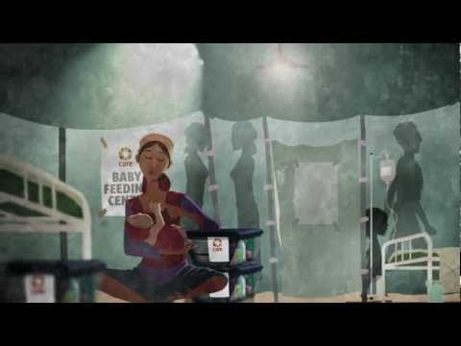
CARE International in an international charity that works across the globe. Here is a brief introduction to their work and history. Take notes as you view the video.

Slide 9
CARE International - Current Campaigns
You will now be given some information about CARE International. You need to make notes under the following headings based on the information in the text.
History of CARE international - the major facts
What is CARE International trying to achieve?
What are their goals to accomplish before 2020?
How are they going to achieve these goals?

Slide 10
Learning Question: How could we create a leaflet to educate people about the work of CARE International?
5. Self Assessment.
4. Constructing a leaflet.
3. Learning about the work of CARE International.
2. What is a leaflet?
Starter: In need of help.

Slide 11
Leaflet: Don’t forget to use sub-headings
Introduction: a brief introduction to what CARE International is
History of CARE International: explanation of how CARE started and became the international charity it is today
What is CARE trying to achieve? Explain the future that CARE is trying to work towards
2020 Goals: what is this project and what are the goals (bullet points may be used with full sentences), as well as how these goals will be achieved
How to get involved: www.careinternational.org.uk, Ways to donate, volunteering opportunities

Slide 12
Learning Question: How could we create a leaflet to educate people about the work of CARE International?
5. Self Assessment.
4. Constructing a leaflet.
3. Learning about the work of CARE International.
2. What is a leaflet?
Starter: In need of help.

Slide 13

Peer Assessment
Swap your book with a partner and peer assess their work in purple pen. You should mark for:
Correct capital letter use (C)
Use of correct sentence structure (NS)
Correct apostrophe use (p)
Written in 3rd Person
Written in a formal style
Uses bullet points with full sentences
Has contact details and next steps at the end
Is detailed and accurate
Provide a WWW and EBL.

Slide 14
What did you improve today?
Knowledgeable
Internationally Minded
Enquiry Based Learning

