Slide 1

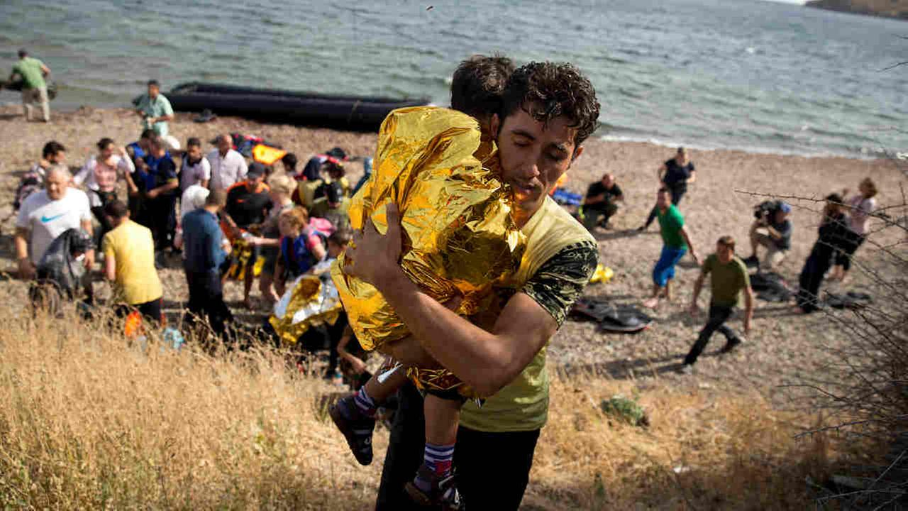
You are now almost at the end of this unit, and you have learnt a lot about the Syrian Refugee crisis, as well as the Syrian Civil War.
Are you more or less informed than your peers in other year groups?
Why? Why not?

Slide 2

GCSE: Paper 2 Language
Reports

Slide 3
Learning Question: How could we create a report to show the opinions of Wilmington Academy students in regards to the Syrian Refugee Crisis?
5. Peer Assessment.
4. Writing a report.
3. Creating a survey and collecting data.
2. What is a report?
Starter: How do your views differ from your peers?

Slide 4

Today you should focus on:
Communication Skills
Balanced
Initiative

Slide 5

What is a report?
A report is designed to inform readers about a topic of investigation, usually for the reference of a person in authority.
They are written in the 3rd Person.
They have a title, and subheadings for each section.
They summarise key facts, within certain subheadings: Introduction, Findings, Recommendations, Conclusions.

Slide 6
Your Task
You are to write a report for the Headteacher of Wilmington Academy, outlining the opinions of students about the Syrian Refugee Crisis.
Genre: Report
Audience: Headteacher of Academy
Purpose: To inform about the views and opinions held by students about the Syrian Refugee Crisis.

Slide 7
Surveys
To write your report, you will need to conduct a survey of your peers, to have the relevant information needed to complete your report.
The purpose of the survey is to find out how much students know about the Syrian Refugee Crisis and their opinions about the Crisis.
Your report should have 10 questions and can be written in a range of styles, which will be shown on the following slides.
You are also able to work in groups of 2-3 for the survey task, but your report will be individually completed.

Slide 8
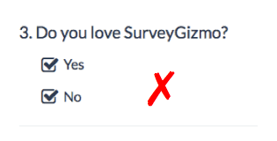
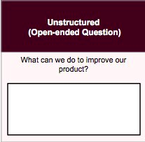
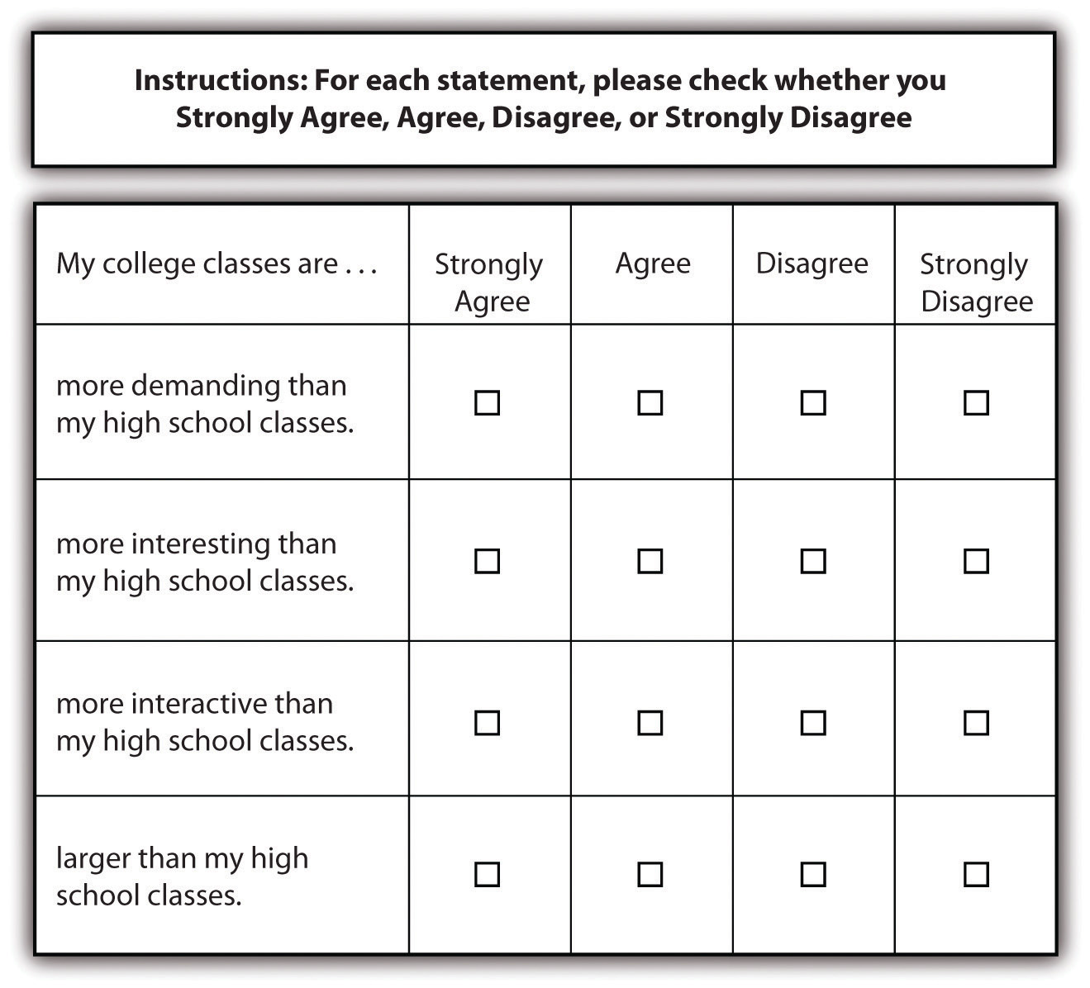
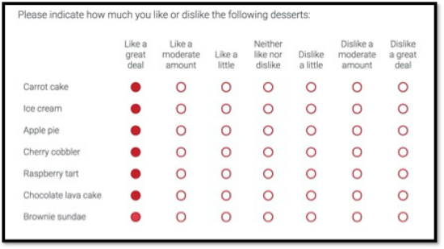
Surveys: Types of Questions
Yes/No Questions
Agree/Disagree Questions
Scaled Questions to indicate intensity of feeling or knowledge
Open-ended Questions

Slide 9
Surveys: Sample Questions
Yes/No Questions:
Agree/Disagree Questions:
Scaled Questions to indicate intensity of feeling or knowledge:
Open-ended Questions:
Do you know what the Syrian Refugee Crisis is?
Yes ⏭ No ⏭
Do you agree that more Syrian refugees should be settled in the UK?
Strongly Agree ⏭ Agree ⏭ Disagree ⏭ Strongly Disagree ⏭
Which of the following things do you know about the Syrian Refugee Crisis?
When it started ⏭ Who started it ⏭ Where refugees currently live ⏭ About the Civil War ⏭ The conditions refugees are living in ⏭
What reasons would you give for why refugees should/should not be allowed into the UK?

Slide 10
Surveys
Create your survey of 10 questions.
You will be able to visit three classes to ask their opinions. You will need to record their year group only. You will need to have three copies of your survey to record results. (Note: you may want to record how many students you asked were male/female).
Visit the classes and tally up responses to your questions.
Come back to class and convert your tallies into percentages of students who responded the same way to each of your questions.

Slide 11
Surveys: Analysing Your Results
Now you need to look at what the results mean.
Example:
You asked the question “Do you agree that more Syrian refugees need to be settled in the UK?”
Of the 80 students you asked, 4 (5%) strongly agreed, 12 (15%) agreed, 6 (7.5%) strongly disagreed, and 58 (72.5%) disagreed.
What does this data show you?
How do most students feel about this questions?
Did you discover reasons for why they felt this way?
What could be done to challenge their opinions or help them become more informed?

Slide 12
Report: Don’t forget to use sub-headings
Introduction: state what the report is about and who it was written for (who is the intended audience?), also explain what the recommendations will be in summary form
Findings: This is where you report what you learnt from your survey - what patterns or interesting results were there?
Conclusions: What does the information tell you about the attitudes of young people in Wilmington Academy towards the Syrian Refugee Crisis?
Recommendations: To address what you discovered in your survey, what are you going to recommend the school does?

Slide 13

Peer Assessment
Swap your book with a partner and peer assess their work in purple pen. You should mark for:
Correct capital letter use (C)
Use of correct sentence structure (NS)
Correct apostrophe use (p)
Written in 3rd Person
Written in a formal style
Has conclusions and clear recommendations at the end
Is detailed and accurate
Provide a WWW and EBL.

Slide 14
What did you improve today?
Communication Skills
Balanced
Initiative

